Slide 1
Digital Innovation
Closing the Loop
© YouGov 2016 (Strictly Private and Confidential)

Slide 2
Contents
Landscape
Challenges
Solutions
© YouGov 2016 (Strictly Private and Confidential)

Slide 3
The Landscape
Closing the Loop
© YouGov 2016 (Strictly Private and Confidential)

Slide 4
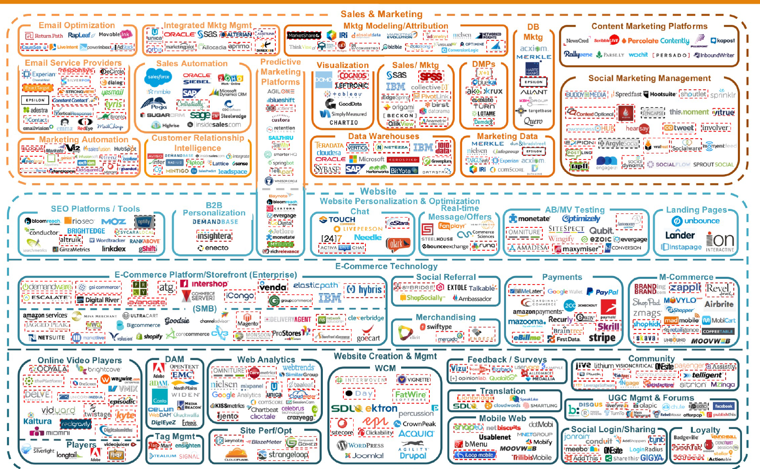
Marketing Technology
Source: LUMAscape (www.lumapartners.com)
© YouGov 2016 (Strictly Private and Confidential)

Slide 5
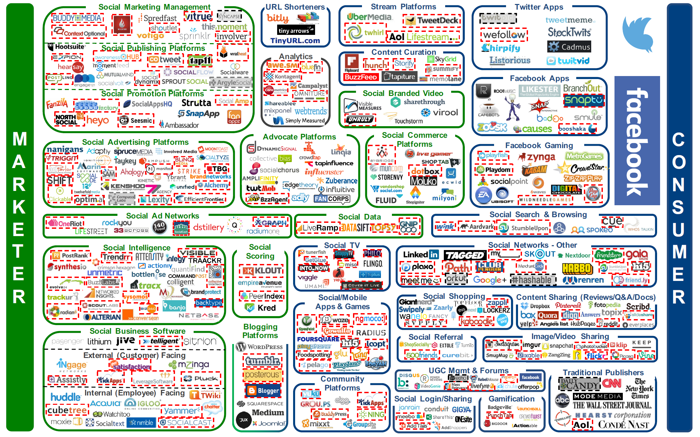
Digital Channels
Source: LUMAscape (www.lumapartners.com)
© YouGov 2016 (Strictly Private and Confidential)

Slide 6
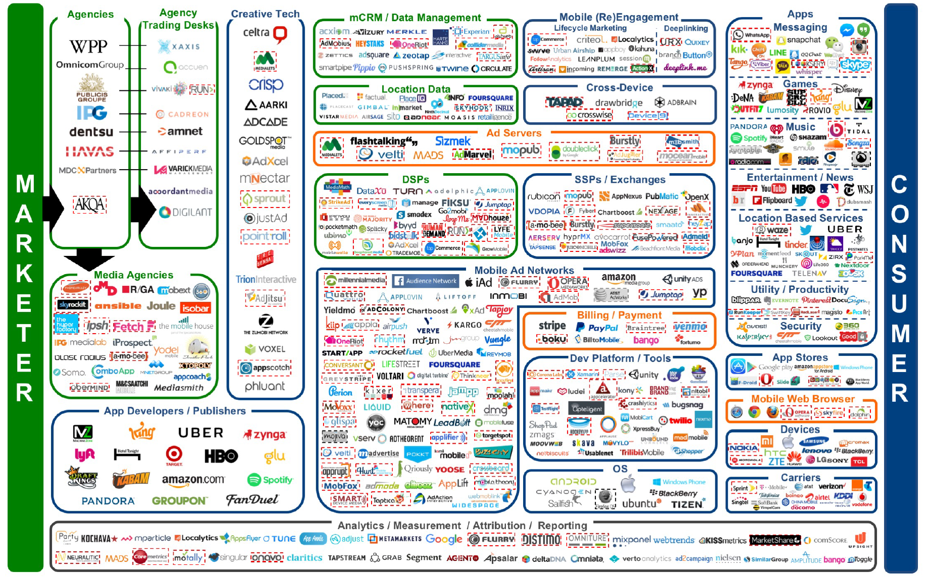
Mobile
Source: LUMAscape (www.lumapartners.com)
© YouGov 2016 (Strictly Private and Confidential)

Slide 7
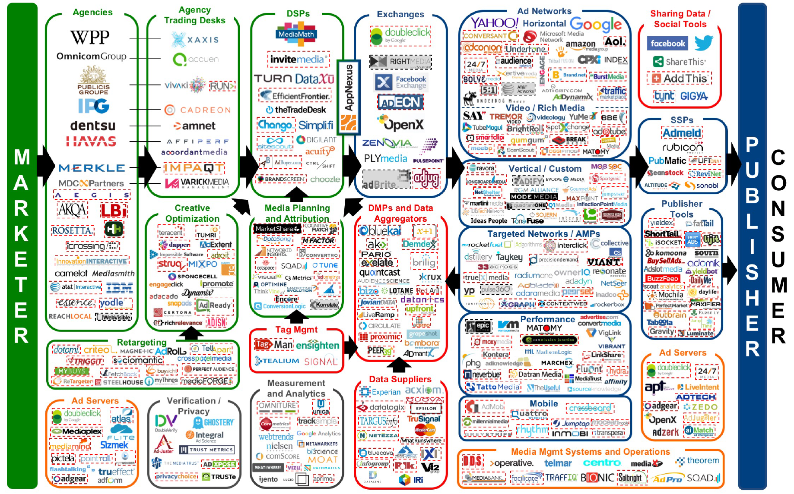
Programmatic
Source: LUMAscape (www.lumapartners.com)
© YouGov 2016 (Strictly Private and Confidential)

Slide 8
Challenges
Closing the Loop
© YouGov 2016 (Strictly Private and Confidential)

Slide 9
What we hear…
Q. How can I better use the data I already have?
Q. What can deeper profiling tell me that I don’t already know to gain a competitive edge in my sector?
Q. How can I better personalise creative to create better engagement?
Q. How can I action my segmentation in the digital space?
Q. How do I know if my campaign is reaching the right people?
Q. How can I tell if my campaign has had a positive effect on my brand and sales?
© YouGov 2016 (Strictly Private and Confidential)

Slide 10
Solutions
Closing the Loop
© YouGov 2016 (Strictly Private and Confidential)

Slide 11
Planning
Delivery
How can I better use the data I already have?
What can deeper profiling tell me that I don’t already know to gain a competitive edge in my sector?
How can I better personalise creative to create better engagement?
How can I action my segmentation in the digital space?
How do I know if my campaign is reaching the right people?
How can I tell if my campaign has had a positive effect on my brand and sales?
© YouGov 2016 (Strictly Private and Confidential)

Slide 12
Planning
Delivery
Fuse
Action
Profile
Track
Plan
Measure
© YouGov 2016 (Strictly Private and Confidential)

Slide 13
Closing the Loop Model
Fuse
Profile
Plan
1
2
3
Action
Track
Measure
4
5
6
© YouGov 2016 (Strictly Private and Confidential)

Slide 14
How can I better use the data I already have?
Fuse
Segment (1)
Segment (2)
Segment (3)
Segment (4)
Male
25-34
Sports Drinks Consumers
Football
Male
25-34
Sports Drinks Consumers
Cycling
Male
25-34
Sports Drinks Consumers
Athletics
Male
25-34
Sports Drinks Consumers
Swimming
Segment (5)
Segment (6)
Segment (7)
Segment (8)
Male
35-44
Sports Drinks Consumers
Football
Male
35-44
Sports Drinks Consumers
Cycling
Male
35-44
Sports Drinks Consumers
Swimming
Male
35-44
Sports Drinks Consumers
Running
© YouGov 2016 (Strictly Private and Confidential)

Slide 15
What can deeper profiling tell me that I don’t already know to gain a competitive edge in my sector?
Profile
Interests
General…
Business and Finance
International News
Travel and Holidays
Personal Finance
Politics
Hotels & Guides
Customer of…
TripAdvisor
Booking.com
trailfinders.com
Rough Guides
lastminute.com
Issues
Top importance…
Republicanism
The EU
Nuclear energy
Scottish independence Railway nationalisation
TV Shows
Watched…
Star Trek: Enterprise
Breakfast
Modern Family
Football Gold
Frasier
Languages
Spoken…
German
Spanish
Italian
French
Portuguese
Airlines
Customer of…
British Airways
easyJet
Aer Lingus
Singapore Airlines
Air New Zealand
Airline Loyalty
Member of…
British Airways
Lufthansa
American Airlines
Air France
Delta Airlines
Your Customers Under a New Lens
World Places
Liked…
New York City
Venice
Germany
Portugal
Japan
Life Events
Next 12 months…
Travel abroad
Buy a house
Get married
Get engaged
Buy a car
Mental Strengths
Personality…
Experience
Processing speed
Emotional intelligence
Verbal
Mathematical
Magazines
Read…
The Economist
InStyle
Esquire
Ideal Home
Men's Fitness
Radio Stations
Listened last 30 days…
BBC Radio 2
BBC Radio 5 Live
LBC 97.3
BBC Radio 4
BBC Radio 3
Airport Activities
Regularly partake…
Use airline lounges
Shop at pharmacies
Go to the pub
Use the airport WiFi
Shop at Duty Free
TV Channels
Watched last 30 days…
BBC One
ITV
BBC Two
More 4
BBC News
Exchange Services
Last 12 months…
Post Office
Saga
Sainsbury’s Finance
The Co-operative Bank Plc
American Express
Career
Job title…
Engineer
Network Manager
Trainer
Police Officer Teacher
© YouGov 2016 (Strictly Private and Confidential)

Slide 16
How can I better personalise creative to create better engagement?
Plan
Mental Strengths
And some of the oddities…
Social Skills
Musical
Emotional Intelligence
Memory
Aesthetic
Animal that best describes their personality: Wolf
Actor would like to play them: Leonardo DiCaprio / Kiera Knightley
Things believed in: Karma / cosmic justice
Would most like to be named after: A theory
Introvert or extrovert: Get energy by being in a group of people
Outlook on the world in general: Getting better
Cat or dog person: Dog
Opinion on food: I eat to live
Positive Traits
Well Educated
Organised
Encouraging
Independent
Perseverant
© YouGov 2016 (Strictly Private and Confidential)

Slide 17
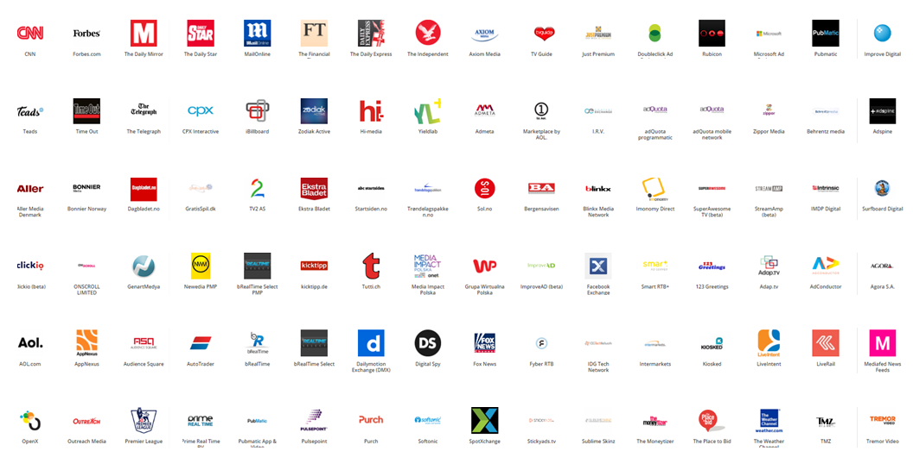
How can I action my segmentation in the digital space?
Action
DMP Cookie Pool (60m+)
Partner Cookies (250,000)
Your Target Market (10,000)
Your Extended Market (600,000)
© YouGov 2016 (Strictly Private and Confidential)

Slide 18
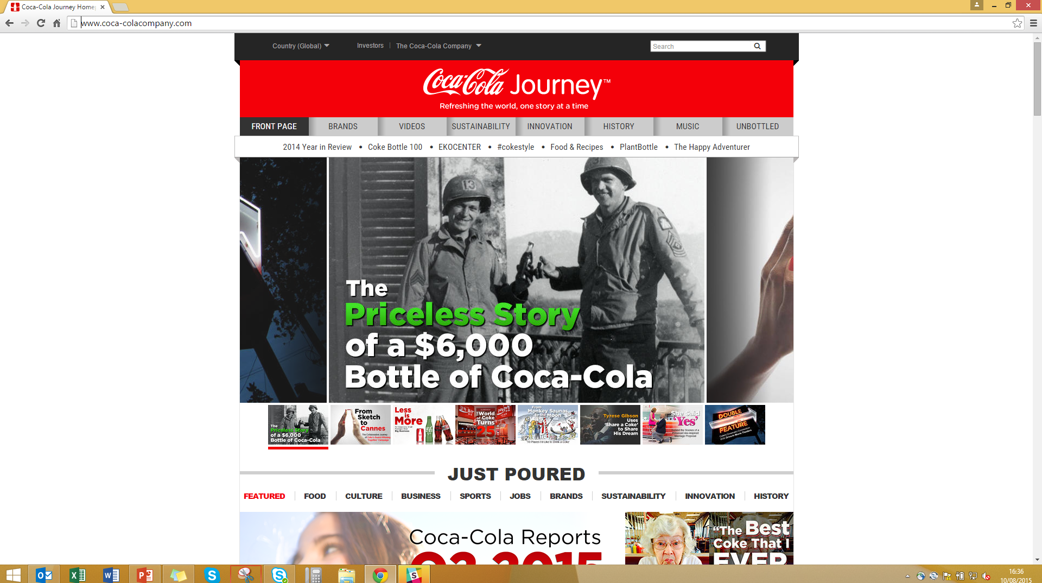
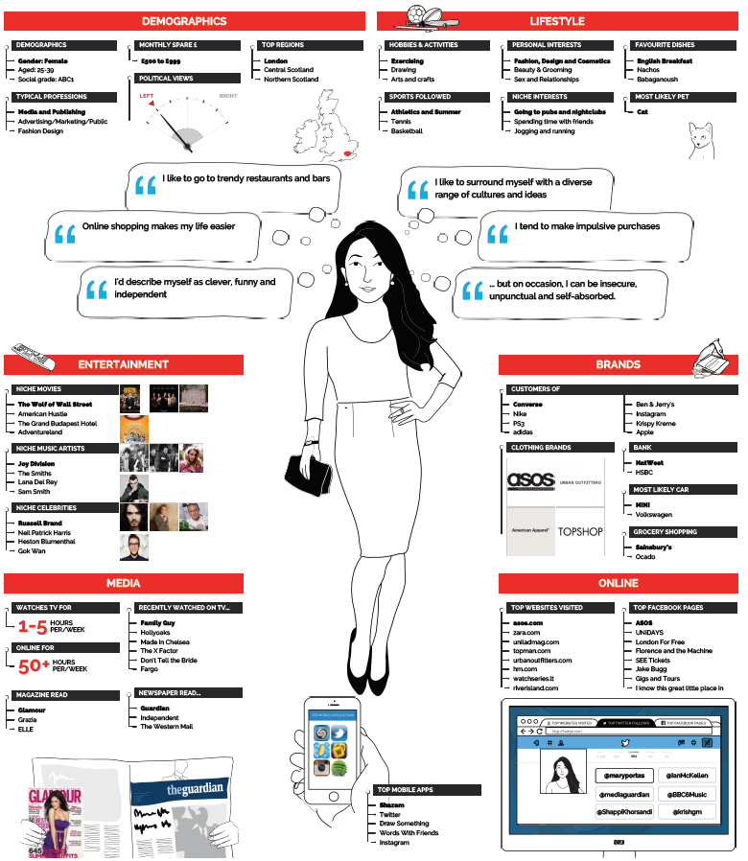
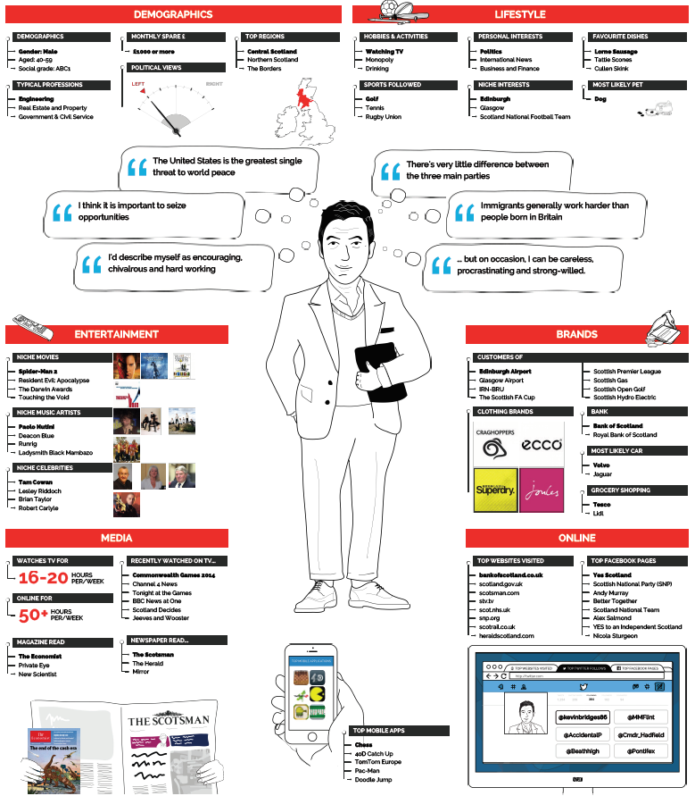
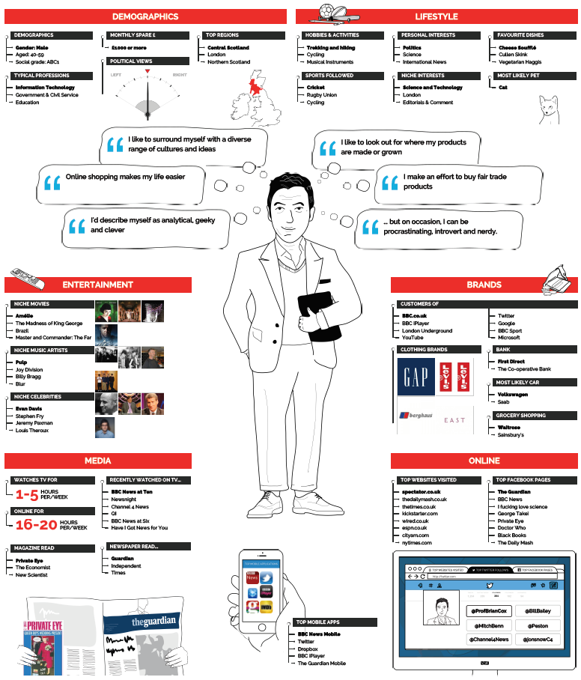
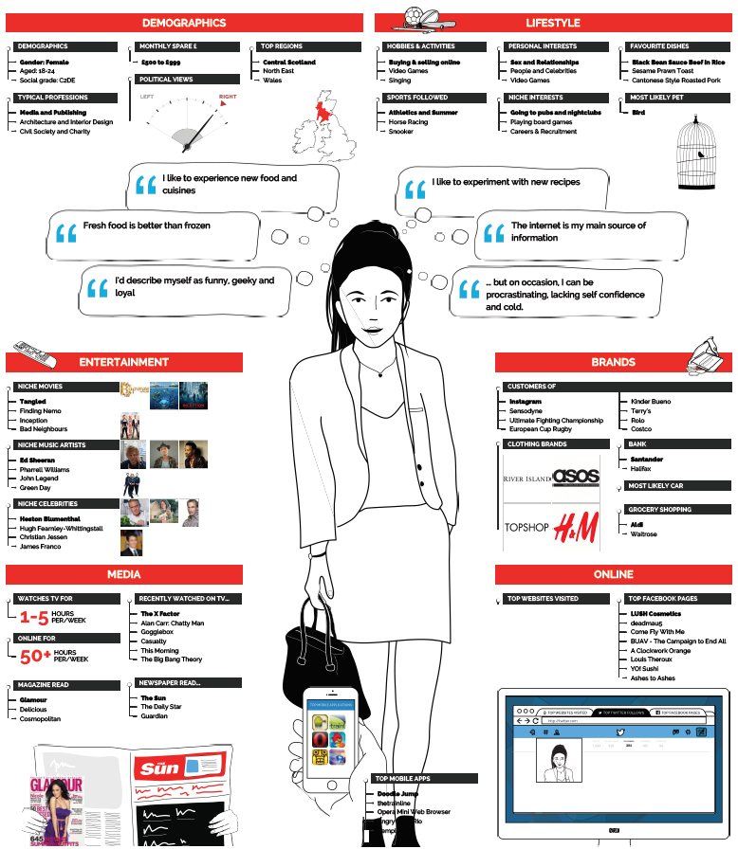
How do I know if my campaign is reaching the right people?
Track
Pixels
Creative (A) Exposed
Creative (B) Exposed
Creative (C) Exposed
Non-Exposed
Fusion and Group Creation
© YouGov 2016 (Strictly Private and Confidential)

Slide 19
How can I tell if my campaign has had a positive effect on my brand and sales?
Measure
Core Brand Metrics
Bespoke Brand Metrics
Your Key Segments
© YouGov 2016 (Strictly Private and Confidential)

Slide 20
Actioning with YouGov
Closing the Loop
© YouGov 2016 (Strictly Private and Confidential)

Slide 21
Putting the workflow into place with YouGov
Connecting and Actioning Data
1
2
3
Fuse
Profile
Plan
Fuse brand segmentations and custom trackers directly into YouGov Profiles to create a dynamic and constantly updating view of your segments
Profile segments of interest across 120,000 data points (offline, online, mobile and social attributes) to refine and develop target groups for customer retention and acquisition strategies
Share created target groups directly with connected media agencies who can re-contact segments with bespoke questions for a campaign specific focus
YouGov Custom
YouGov Profiles
YouGov Omnibus
4
5
6
Action
Track
Measure
Connected agencies can then directly buy against those created audiences (programmatically) through YouGov Programmatic (by connecting with various YouGov DSP)
Profile who is viewing programmatically seeded content through YouGov AdProfiler (via pixels added to seeded creative) and analyse those consumers within YouGov Profiles
Report back campaign effectiveness and ROI daily via YouGov BrandIndex and create custom filters using data segments created in YouGov Profiles
YouGov Programmatic
YouGov AdProfiler
YouGov BrandIndex
© YouGov 2016 (Strictly Private and Confidential)

Slide 22
#ThankYou
© YouGov 2016 (Strictly Private and Confidential)

