Slide 1
Youth Survey – India
On behalf of Vodafone
Fieldwork: 17th to 24th January 2018

Slide 2
HVP_q1. Which, if any, of the following statements do you agree with? (Please select all that apply)
The hardest challenge for my generation is finding a well-paid, permanent job
My future happiness depends on me having a well-paid, permanent job
I believe that with the growth of Artificial Intelligence and the use of Big Data and automation, most jobs and professions will be replaced by machines within 50 years
Academic qualifications are less important than apprenticeships/ work experience
I would rather work for myself/be an entrepreneur than work for a company
Finding a job focused on social good is more important to me than a big salary
Most people in my generation are unlikely to have a comfortable retirement
Higher education isn’t worth the debt it incurs
I will never be able to afford the quality of life of my parents’ generation
I will never be able to afford to buy my own home
None of these
Base: 18 to 24 year old Indian Adults (502)

Slide 3
HVP_q2. For the following question, even if you are not sure what each of the following careers are, we are still interested in your opinion based on the title alone...
Which THREE, if any, of the following appeal to you the most as a potential future career? (Please select up to THREE options)
Part 1
YouTuber/ video blogger
Teacher/ Teaching assistant
Internet of things (IOT) product designer
Cyber-security specialist
App designer
Accountant/ finance worker
Robotics engineer
Marketing/ sales
Journalist
Fitness instructor/ sportsperson
Pilot
Base: 18 to 24 year old Indian Adults (502)

Slide 4
HVP_q2. For the following question, even if you are not sure what each of the following careers are, we are still interested in your opinion based on the title alone...
Which THREE, if any, of the following appeal to you the most as a potential future career? (Please select up to THREE options)
Part 2
Nurse or doctor
Coder
Automation engineer
Games designer
Lawyer
Mechanical engineer
Machine learning Analyst
Construction worker
Drone pilot
None of these
Don’t know
Base: 18 to 24 year old Indian Adults (502)

Slide 5
HVP_q3. Thinking about the careers advice, if any, you have received to date during your time in education (i. e. at school, college, university etc.)...
Which ONE, if any, of the following statements would you say BEST applies to you?
I have received careers advice in the past and feel as though it was enough
I have received careers advice in the past but don’t feel as though it was enough
I have not received any careers advice in the past
Don't know/ not sure
Base: 18 to 24 year old Indian Adults (502)

Slide 6
HVP_q4. Thinking generally about ALL of the careers advice you received during your time in education (i. e. at school, college, university etc.)...
Which, if any, of the following statements apply to you? (Please select all that apply)
The careers advice I received focused purely on traditional jobs (e.g. accountant, lawyer, doctor, mechanic, banker etc.)
I received careers advice at university/ college
I received careers advice at school
The careers advice I received did not take my skills into account
The careers advice I received included more future-focused, digital jobs (e.g. robotics engineer, virtual reality surgeon, coder, AI designer, video blogger etc.)
The careers advice I received was better than I expected
The careers advice I received was out-of-date
None of these
Don’t know
Base: 18 to 24 year old Indian Adults that received careers advice to date during their time in education (323)

Slide 7
HVP_q5. Which, if any, of the following statements do you think apply to your current skills and experience? (Please select all that apply)
I am confident I will find a job that matches my skills
I can clearly describe my skills and positive attributes
I don’t know how to best describe my skills and positive attributes
I worry I could lack the skills, experience and connections to find a job I will enjoy
I don’t know what sort of digital jobs are out there to match my skills
I worry I could lack the skills, experience and connections to find any job
I worry I could lack the digital skills necessary to find a job
I don't think the job that best matches my skills and experience has been invented yet
None of these
Don’t know
Base: 18 to 24 year old Indian Adults (502)

Slide 8
HVP_q6. For the following question, by 'digital economy' we mean an economy based on digital technologies. The digital economy will need more digital skills such as artificial intelligence (AI), robotics and coding.
Which, if any, of the following describe how you feel when you hear the term ‘digital economy’? (Please select all that apply)
The digital economy will increase my job opportunities in the future
I feel prepared for the digital economy (i.e. I have the right skills necessary such as coding, robotics, social media management, virtual reality programming and cyber security)
I need more support from others in order to be prepared for the digital economy
I feel underprepared for the digital economy, my education has been too traditional and not digital-focused enough
I feel underprepared for the digital economy, my skills are more traditional and not digital-focused enough
The digital economy will decrease my job opportunities in the future
I am worried that professions I might have entered will not exist in the future because of the digital economy
I am worried I will have no role in the digital economy
None of these
Don’t know
Base: 18 to 24 year old Indian Adults (502)

Slide 9
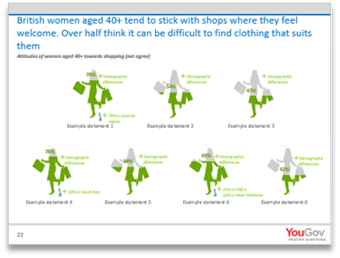
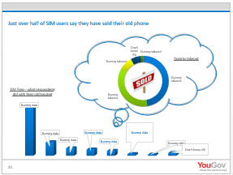
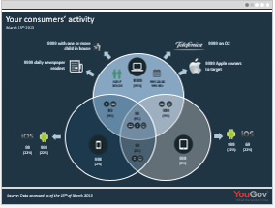
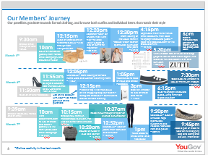
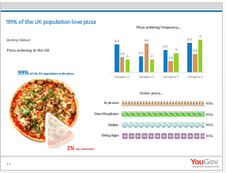
Custom research at YouGov
The charts in this presentation show your "topline" findings but did you know that we are able to do so much more for you?!
YouGov has expert specialised research teams who know your industry and audiences inside-out.
Our sector specialists (Consumer, Digital, Media and Technology, Financial Services, Public Services) combine research expertise with in-depth knowledge to help you identify and analyse your markets, as well as offer actionable insight on how to best achieve your business/ organisation objectives
For more information, contact the Custom Research team on customresearch@yougov.com or call +44 20 7012 6000

